Slide 1
Problem #1 - Levee
Compare to flow net solution:
Q = 5.8e-5 m^3/s/m
Q = 5.0 m^3/d/m

Slide 3
Problem #2 - Excavation
Model left half of problem domain
Trench length = 500 ft

Slide 4
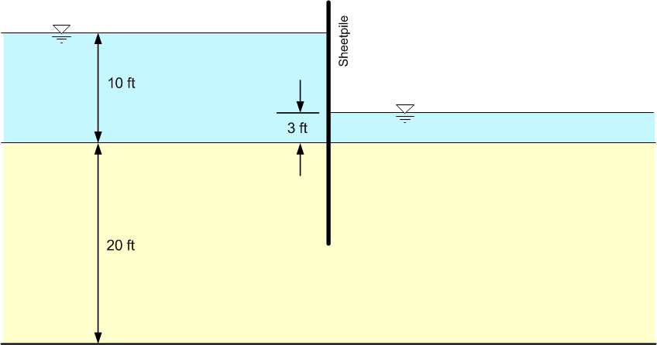
Problem #3 - Sheetpile

